Slide 1

The Great Recession
Increasing Insomnia Rates Since 2007
Elena Adame

Slide 2
Overview
What is Insomnia?
Insomnia is Trending Upward
Insomnia Trends from 2002 – 2012
Identifying States with Highest and Lowest Job Loss Percentages
2008 United States Sleep Study
Another Look at the Data
Sleep Aid Searches
2014 United States Sleep Study
Future Considerations
Notes:
In this presentation, the role of the Great Recession and its effect on the sleep health of the United States populace will be explored. The term “insomnia” will be defined to establish a clear understanding for the audience as to what the term means in relation to this presentation. Next, the presentation will move into discussing how searches for insomnia are trending upward, followed by the trends for reported cases of insomnia from 2002 – 2012. Next, to provide correlation between the Great Recession and sleep health, the states with the highest and lowest job loss percentages will be presented along with their reported sleep deficiencies. Two sleep studies for the United States will be discussed, one set during the Great Recession and one set after it’s official end. Additionally, sleep aid data for four states will be examined. Finally, future considerations for how correlation can be made between the Great Recession and sleep health will be discussed.

Slide 3

What is Insomnia?
Difficulty with sleep initiation, duration, consolidation, or quality, which occurs despite adequate opportunity for sleep.
Notes:
As defined in a Ford, et al. (2015) study, insomnia is the “difficulty with sleep initiation, duration, consolidation, or quality, which occurs despite adequate opportunity for sleep.
For the remainder of this presentation, sleep data will be discussed as it relates to adults over the age of 18 or equal to 18. Insomnia will be discussed as it relates to either the reported difficulty falling asleep or insufficient sleep in total number of hours. Sleep data for children or teenagers under the age of 18 will not be considered in this presentation.
One important fact to consider is it is not known how much of the Google Trends data was produced by children ages 17 and under. Data collected from other studies only included that of adults ages 18 and up. It is not known how the removal of data provided by users under the age of 18 would affect the trends observed during this study.
References:
Ford, E. S., Cunningham, T. J., Giles, W. H., & Croft, J. B. (2015). Trends in insomnia and excessive daytime sleepiness among U.S. adults from 2002 to 2012. Sleep medicine, 16(3), 372–378. https://doi.org/10.1016/j.sleep.2014.12.008

Slide 4
Insomnia is trending upward
FIGURE 1: Google Trend data showing the term ‘insomnia’ searched in the United States from January 2004 to April 2021.
Notes:
Looking at Google Trend data for the search term ‘insomnia’ for the United States, a downward trend can be observed from January 2004 to July 2007. A spike in searches for insomnia can be seen for October 2007. This spike marks the upward trend in searches for the term insomnia. Searches for this term continue to increase, finally hitting the maximum (100) in January 2021. Yet what caused this sudden upward trend for users searching insomnia?
Looking at big events for the period, it was noticed that the upward trend coincides with the biggest financial crisis the United States has seen since the Great Depression, the Great Recession. This event was officially declared in December of 2007 and was officially declared to have ended in June of 2009 (Rich, 2013). This period was marked with “increased job insecurity, feelings of powerlessness, increased workload, and changes in job scope,” (Modrek et al., 2015). The increased stressors surrounding work-life led to what Modrek et al. (2015) determined was an increased use of 11% for sleep aids.
The study conducted by Modrek et al. (2015) showed that there was a large decreasing trend of sleep aids prior to the recession. Looking at Figure 1, their findings line up with the data provided by Google Trends. As previously stated, from January 2004 to July 2007, users in the United States were showing a decrease in searches related to insomnia.
Data collected from the Bureau of Economic Analysis and the Center of Budget and Policy Priorities show that while the Great Recession officially ended in June of 2009, the economy did not fully recover the total amount of jobs lost until mid-2014 (2019).
References:
Figure 1: Google Trends
Center on Budget and Policy Priorities. (2019, June 6). Chart Book: The Legacy of the Great Recession. Center on Budget and Policy Priorities. https://www.cbpp.org/research/economy/the-legacy-of-the-great-recession#:~:text=Progress%20erasing%20the%20jobs%20deficit,continued%20to%20add%20jobs%20thereafter.
Modrek, S., Hamad, R., & Cullen, M. R. (2015). Psychological well-being during the great recession: changes in mental health care utilization in an occupational cohort. American journal of public health, 105(2), 304–310. https://doi.org/10.2105/AJPH.2014.302219
Rich, R. (2013, November 22). The Great Recession. Federal Reserve History. https://www.federalreservehistory.org/essays/great-recession-of-200709.

Slide 5
A
B
FIGURE 2: Google Trend data showing searches for three name brand sleep aids from 2004 to 2021.
Notes:
In Figure 2, users in the United States used Google to search for three name brand sleep aids: Sonata, Lunesta, and Ambien. Modrek et al. (2015) reported there was a decreasing trend of sleep aid usage before the recession. Looking at the data show in Figure 2, that claim would line up. The two shaded areas on the graph represent the following: A) the period in which the Great Recession was officially declared to have started and B) the period in which the Great Recession was official declared to have ended.
Sleep aid searches remained relatively stable during the period of the Great Recession. However, the trend shows an increase for searches related to Sonata
On interesting point to make note of is the trend seen for Lunesta. If searches for sleep aids are indicative of usage, then it would appear that usage of the drug continued downward versus increasing upon the start of the Great Recession. For this reason, when looking at sleep aid usage for states impacted by the Great Recession, Lunesta was not included in research.
Two other sleep aids were considered for this study as well. Restoril and Rozerem. The data observed from Google Trends for the two drugs was not used for the following reasons. Rozerem showed similar trends as Lunesta, spiking late 2006 to early 2007 but then continuing on a downward trend that did not reflect what was reported by Modrek et al. (2015). The trend observed for Restoril was inconsistent with the time period. Further research into this sleep aid and its relationship with the states impacted by the Great Recession would be needed. For this given study, data for Restoril was not used.
References:
Figure 2: Google Trends
Modrek, S., Hamad, R., & Cullen, M. R. (2015). Psychological well-being during the great recession: changes in mental health care utilization in an occupational cohort. American journal of public health, 105(2), 304–310. https://doi.org/10.2105/AJPH.2014.302219

Slide 6
Insomnia trends from 2002 -2012
Figure 3: Age-adjusted prevalence of insomnia among participants aged 18+ years, National Health Interview Survey 2002
Notes:
In a study conducted by Ford et al. (2015), the prevalence of insomnia among adults aged 18 and up was determined. While Figure 3 may indicate that overall, the rates did not increase drastically within year groups, looking at the data in a different light brings a new perspective.
According to the U.S. Bureau of Labor Statistics, the prime working age during the Great Recession was 25 to 54 years of age (2018). Beginning by looking at participants of the Ford et al. study grouped in the 25-34 year group, the reported percent of insomnia was 12.9.%. Five years later, half of these users would still be categorized within the same year group; the other half would be categorized within the next year group, 35-44.
For those remaining within the same year group, the percent of insomnia reported was 14.1%. This shows a rise of 1.2% within the span of five years. For participants who were categorized in the next year group up, the reported percentage of insomnia was 16.6%, an increase of 3.7%.
Looking at the ten-year difference of reported insomnia in participants, there is a 3.7% increase from the 25-34 to the 35-44 category. Between the 35-44 and 45-54 categories, there is a 4.4% increase. This data would suggest that as participants continued to remain within the workforce, the increased stress and uncertainty of the Great Recession affected their sleep quality and habits. A decrease in reported insomnia is not seen until participants age out of the 55-64 category, suggesting that participants continued to work past the prime age of the work force.
References:
Ford, E. S., Cunningham, T. J., Giles, W. H., & Croft, J. B. (2015). Trends in insomnia and excessive daytime sleepiness among U.S. adults from 2002 to 2012. Sleep medicine, 16(3), 372–378. https://doi.org/10.1016/j.sleep.2014.12.008
U.S. Bureau of Labor Statistics. (2018, April 1). Great Recession, great recovery? Trends from the Current Population Survey : Monthly Labor Review. U.S. Bureau of Labor Statistics. https://www.bls.gov/opub/mlr/2018/article/great-recession-great-recovery.htm#:~:text=During%20the%20recession%2C%20the%20unemployment,(See%20figure%203.).
les, W. H., & Croft, J. B. (2015). Trends in insomnia and excessive daytime sleepiness among U.S. adults from 2002 to 2012. Sleep medicine, 16(3), 372–378. https://doi.org/10.1016/j.sleep.2014.12.008

Slide 7
C
B
A
Figure 4: Percentage of Job Losses/Gains 2007-2009 in percentage of December 2007 jobs broken down by A) 5 States with Highest Job Loss, B) 5 States with Medium Job Loss, and C) 5 States with Lowest Job Loss
Notes:
Connaughton and Madsen (2012) wrote a paper identifying how the Great Recession affected the Job Loss and Gain for each of the 50 states. Their findings showed that the states listed in Group A in Figure 4 reported the largest percentage of job losses from 2007 to 2009.
States listed in Group C reported the lowest percentage of job losses for the same time period, with Alaska and North Dakota even reporting a small percentage of job growth.
States listed in Group B reported a percentage of job loss that was near the average reported for the total 50 states.
Keeping in mind that Modrek et al. (2015) reported an increase of sleep aids in response to the stressors introduced by the Great Recession, it was thought that states in Group A would report a higher percentage of insomnia. On the next slide, the regional locations of the states listed in the groups can be seen along with their reported percentage of insomnia for 2008.
References:
Connaughton, J. E., & Madsen, R. A. (2012). U.S. state and regional economic impact of the 2008/2009 recession. Journal of Regional Analysis and Policy, 42(3), 177–187. https://doi.org/10.22004/ag.econ.143779

Slide 8
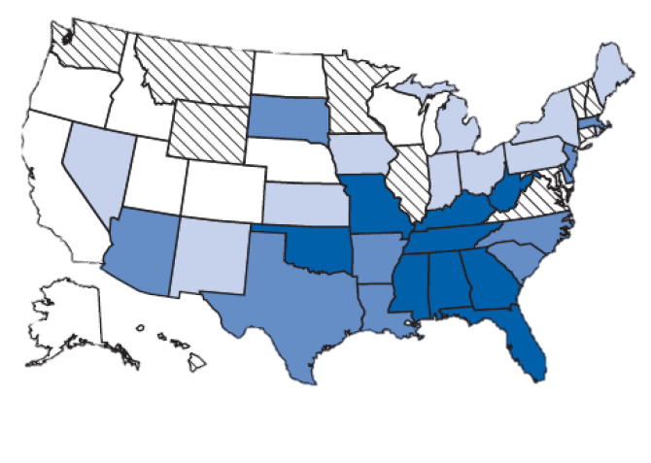
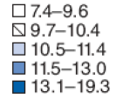
B
C
C
A
A
C
B
B
A
A
B
C
C
A
Figure 5: Age Adjusted percentage of adults who reported 30 days of insufficient rest or sleep during the preceding 30 days – Behavior Risk Factor Surveillance System, United States, 2008.
Notes:
From the previous slide, states in Group A were identified as states with the highest percentage of job losses from 2007 to 2009. Looking at the map in Figure 5, only three of the states in Group A are regionally similar and appear on the West Coast. The remaining two states, Michigan and Florida, are on the opposite side of the country. Only Florida is listed in the highest category of adults who reported 30 days of insufficient rest or sleep. All of this information does not line up with the previous theory: That states with a higher percentage of job loss would report a higher percentage of sleep trouble.
Another interesting point to make note is that only two states in Group B are regionally similar. Connecticut and New Jersey both reported job loss percentages within 0.05% of each other yet they do not exist within the same sleep categories listed in Figure 5. Connecticut reports insufficient sleep in the 9.7-10.4 category while New Jersey reports insufficient sleep percentages in the 11.5-13.0 category.
Only three states in Group C are regionally similar. The information presented by Figure 5 and Figure 4 line up with the theory when speaking of North Dakota and Alaska. Both states reported positively for Job Loss/Gain and both states are in the lowest category of sleep insufficiency. What does not line up is the information regarding South Dakota and Nebraska. If a positive correlation between job loss and sleep deficiency is to be assumed, it would make sense for Nebraska to be in a higher sleep deficiency category than South Dakota, given that Nebraska reported job less 0.88% higher.
The final and most interesting note surrounding Figure 5 is that apart from Mississippi and Florida, there are 7 states that do not appear in Figure 4 that are categorized as the highest reporting states with sleep deficiencies. Figure 6 on the next slide breaks down the job losses reported for these states.
References:
Centers for Disease Control and Prevention. (2009, October 30). Perceived Insufficient Rest or Sleep Among Adults --- United States, 2008. Centers for Disease Control and Prevention. https://www.cdc.gov/mmwr/preview/mmwrhtml/mm5842a2.htm.
Factor Surveillance System 2014

Slide 9
Figure 6: Percentage of Job Losses/Gains 2007-2009 in percentage of December 2007 by state with the largest reporting insomnia percentages in 2008
Notes:
The 9 states shown on Figure 6 above all have job loss percentage as being below or above the states listed in Groups A and C. There are two factors that link all of these states together: 1) They all reported sleep deficiencies between 13.1 and 19.3 % and 2) they are all located withing the same region of the United States.
These states are identified as being part of the Southern Region of the United States. From 1979 to 2007, this region only had an income growth of 37.6%, as opposed to the 59% income growth of the Northeast. However, the South’s income growth was still 10% higher than those of the Midwest and Western regions (Sommeiller and Price, 2014). So this does not fully explain why these states, with median job loss percentages, reported higher than average sleep deficiencies.
Another reason may be due to the poverty level seen in the Southern Region. According to the 2010 Joint Economic Report released by Congress, during the time period of 2007 to 2010, the Southern region of the United States saw the largest increase in poverty. At the time in which the 2010 report was published, the South had 16.9% of it’s populace living in poverty. The increasing rates of poverty combined with the effects of the Great Recession in limiting jobs, may have worked to influence the sleep deficiencies seen for the states listed in Figure 6.
References:
Connaughton, J. E., & Madsen, R. A. (2012). U.S. state and regional economic impact of the 2008/2009 recession. Journal of Regional Analysis and Policy, 42(3), 177–187. https://doi.org/10.22004/ag.econ.143779
Joint Economic Committee, Hinchey, M. D., Hill, B. P., Sanchez, L., Campbell, J., Burgess, M. B., … Cummings, E. E. [Report], The 2010 Joint Economic Report (2010). U.S. Government Printing Office.
Sommeiller, E., & Price, M. (2014, February 19). The Increasingly Unequal States of America: Income Inequality by State, 1917 to 2011. Economic Policy Institute. https://www.epi.org/publication/unequal-states/.

Slide 10
Figure 7a
Figure 7b
Figure 7c
Figure 7d
Figures 7a-d: Google Trends data for searches related Ambien and Sonata. The states with the highest four Percentage of Job Losses/Gains 2007-2009 from Figure 6 are shown above.
Notes:
In Figures 7a-d, search data for Ambien and Sonata, two popular name brand sleep aids, were collected for the four states with the highest percentage of job losses from Figure 6.
The shaded areas of the figures represent the time period of the Great Recession and the time period in which information from Figure 6 was collected.
In Figure 7a for Florida, an increase in searches for Sonata was observed beginning in late 2009. Ambien searches remained relatively stable. Over the course of the Great Recession, searches for remain relatively stable for both sleep aids.
Figure 7b is harder to draw a conclusion from. There are spikes seen toward late 2007, yet these do not reach the overall height of the larger spikes seen outside of the shade area. In 2010, there is a large spike in searches for Sonata.
Figure 7C shows that both sleep aids were on the downward trend prior to the Great Recession. In the shaded area, searches for Ambien spike higher than average. This may be indicative of individuals impacted by the Great Recession seeking help.
Figure 7d shows a downward trend in searches for Ambien prior to the recession. During the event, there is a large spike that lasts for all of 2008, a time period central to the Great Recession.
What may be more important than observing what the populace of these states searched for during the Great Recession is what the continued to search for after. As determined by the Center on Budget and Policy Priorities, the United States did not fully recover from the recession until mid-2014. Data scene in all four figures above show that the populace of these states continued to search for, and in three of the four cases, searched more for sleep aids after the end of the recession. Data show in Figure 7b for Tennessee returns to the pre-recession levels, even with a spike seen in Sonata during 2010. Data show for the other three figures shows that the populace of those states had higher searches for sleep aids.
References
Center on Budget and Policy Priorities. (2019, June 6). Chart Book: The Legacy of the Great Recession. Center on Budget and Policy Priorities. https://www.cbpp.org/research/economy/the-legacy-of-the-great-recession#:~:text=Progress%20erasing%20the%20jobs%20deficit,continued%20to%20add%20jobs%20thereafter.
Figures 7a-d: Google Trends

Slide 11
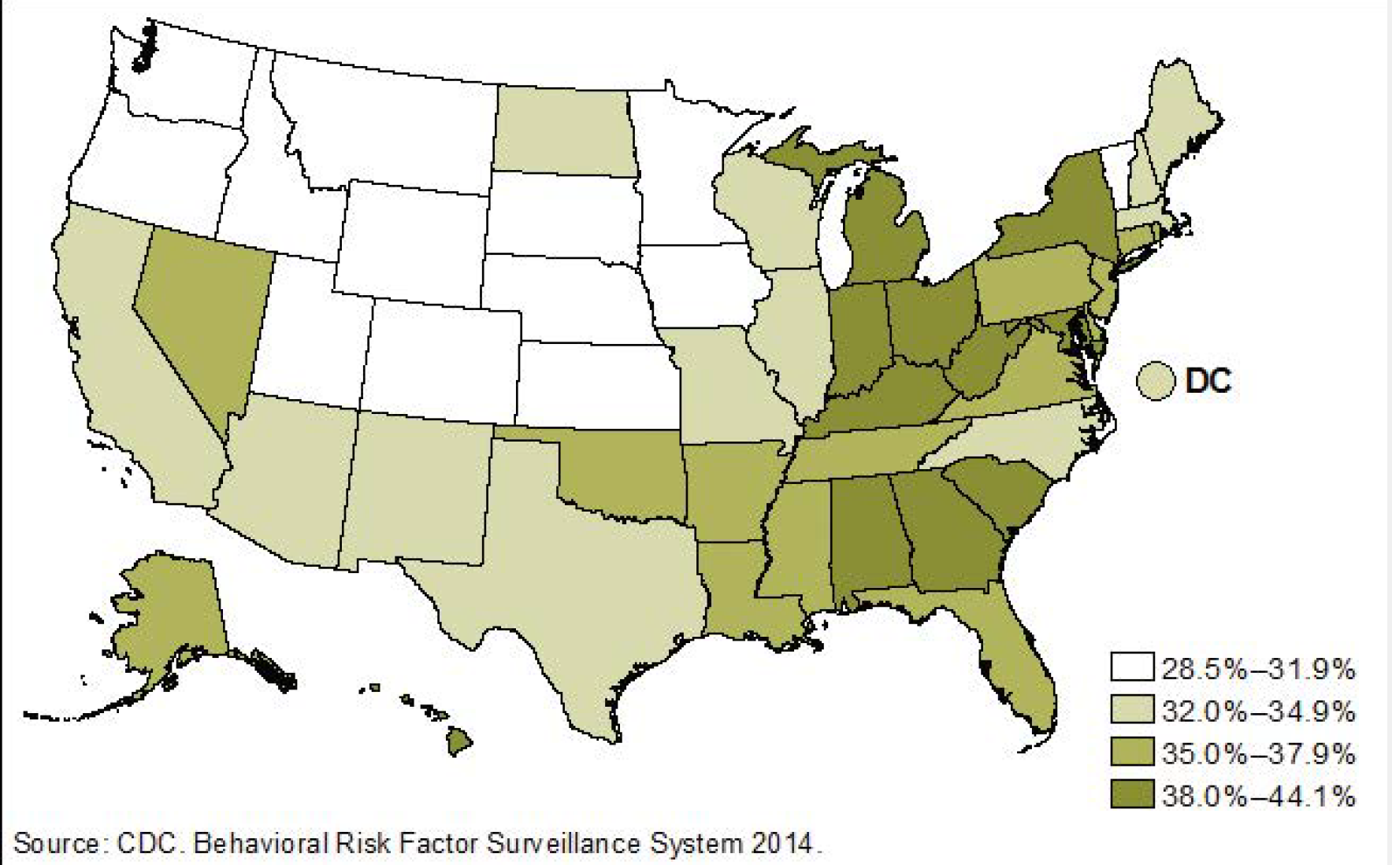
B
C
C
A
A
C
B
B
A
A
B
C
C
A
Figure 8: Age-adjusted prevalence of short sleep duration (<7 hours) among adults aged 18+ years, by State, United States, 2014
Notes:
Figure 8 shows the prevalence of insufficient sleep for adults aged 18 and above. This figure was included to show a longitudinal example of how the affects of the Great Recession continued to be felt long after it’s end in 2009.
As previously stated, data collected by the Bureau of Economic Analysis and the Center of Budget and Policy Priorities showed that the economy did not fully recover until mid-2014. This data for this figure was collected in 2014 and shows that a large majority of the states listed in Figure 6 were still reporting insufficient sleep 5 years after the end of the Great Recession.
A majority of the states listed out in Figure 4, marked by their groups on Figure 8 above, had reached lower levels of reported insomnia.
As it stands, a reasonable assumption could be made that the Great Recession played a large, if not singular, role in creating an environment of anxiety and unsurety throughout the country, especially in the Southern region. This time of uncertainty led many to lose sleep and turn to sleep aids as a result. What is not known, nor can be reasonably explained, is why insomnia trends continued to rise, as observed in Figure 1, long after the period by which the United States was said to have recovered. Further study is need to determine that answer.
References:
CDC. Behavioral Risk Factor Surveillance System 2014
Center on Budget and Policy Priorities. (2019, June 6). Chart Book: The Legacy of the Great Recession. Center on Budget and Policy Priorities. https://www.cbpp.org/research/economy/the-legacy-of-the-great-recession#:~:text=Progress%20erasing%20the%20jobs%20deficit,continued%20to%20add%20jobs%20thereafter.

Slide 12
Further considerations
Were there other events other than the Great Recession that may have caused an increase in insomnia?
Sleep Aid searches for the States listed in Figure 4.
An in-depth look at the Eastern and Southeastern Regions of the United States.
Notes:
Further considerations need to be made to determine if there were other events during the time period of the Great Recession that may have caused an increase in insomnia.
Sleep aid data for the states listed in Figure 4 would be helpful in comparing how the populaces of these states performed compared to those in Figure 6. It would also provide a better understanding of regions in the United States other than the Southern region.
Additionally, an in-depth look at the Eastern and Southeastern regions of the United States should be made. Why was the part of the country performing so poorly for sleep related issues? How did this part of the country recover, time-wise, compared to the other parts of the country?
At this time, sleep data, as seen in Figures 5 and 8, for the time period prior the Great Recession was unable to be obtained. That data would be beneficial in determining the actual health of the United States as it relates to insomnia.

